Slide 1
programmer des portes logiques dans l'ADN

Slide 2
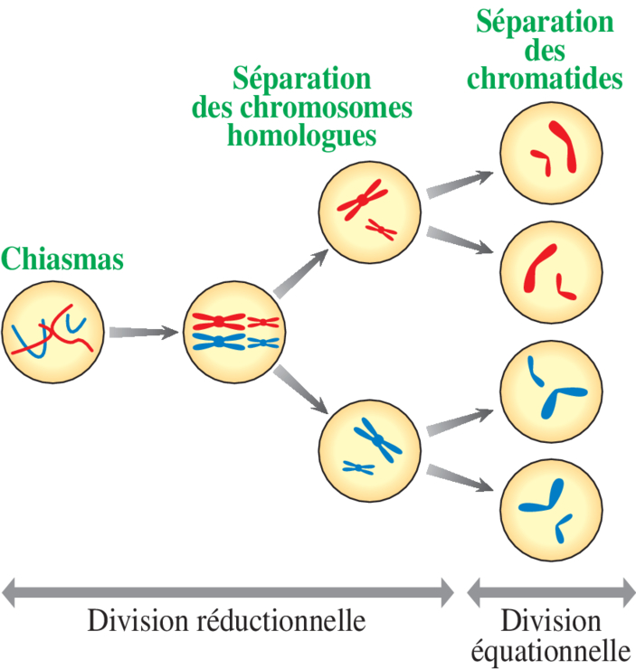
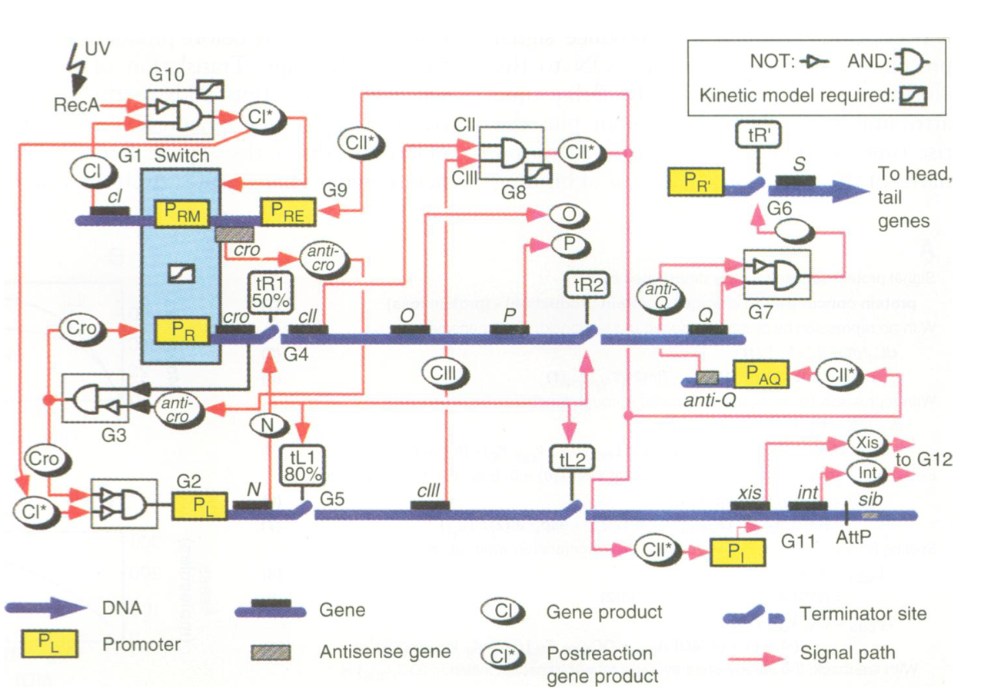
McAdams and Shapiro (1995) Circuit Simulations of Genetic Networks, Science

Slide 3

Ph.D. Genetic Engineering
Developer Advocate Specialist AI/ML @AWS
@tiffanysouterre
Tiffany Souterre

Slide 4


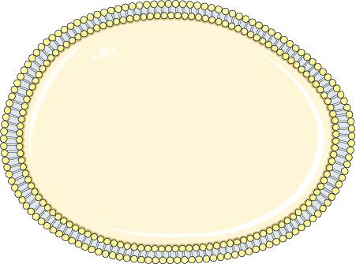

60 milliards de km
3.10¹³ cellules
2 m

Slide 5
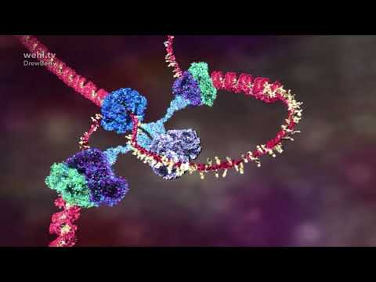

Slide 6





Biologie
Analogie
…ATCGCGATCAGCTCGATC…
ADN
Code Binaire
…0101001010101010010010101…
Signal
Input
Gène
Fonction
Promoteur
Condition
if True:
…
Protéine
Output
Organisme
Application

Slide 7
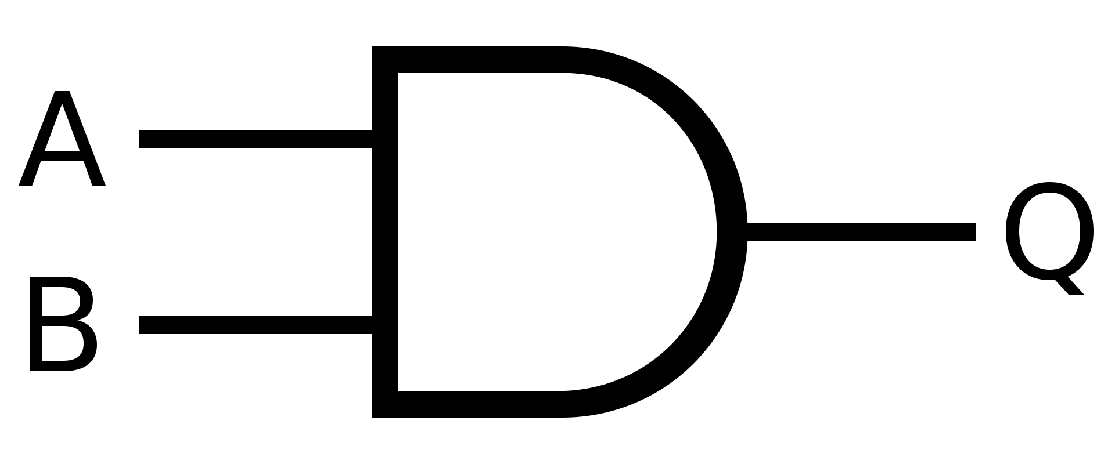
Biologie
AND Gate
Analogie
a
A
A | B | Q
0 | 0 | 0
0 | 1 | 0
1 | 0 | 0
1 | 1 | 1
Q
b
B

Slide 8
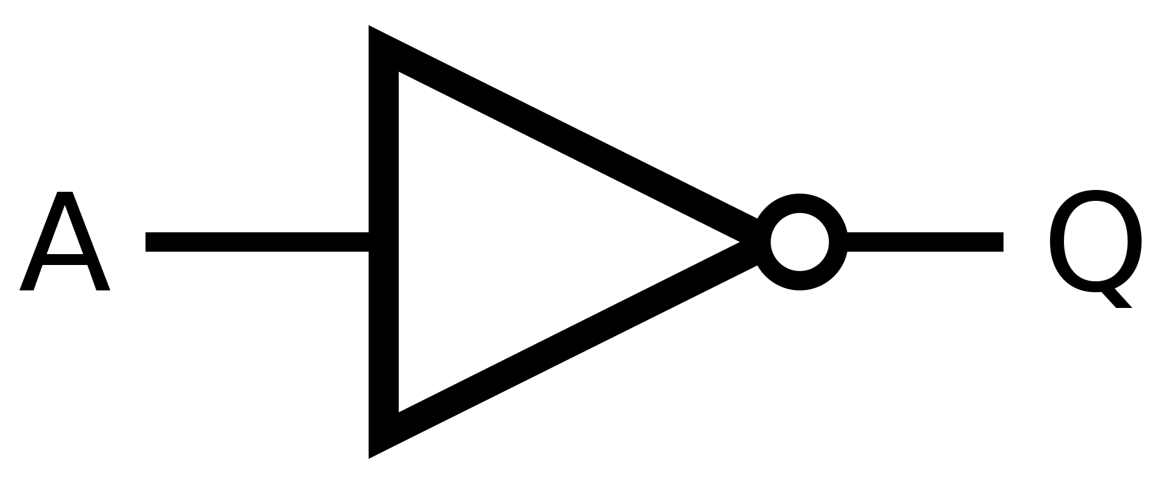
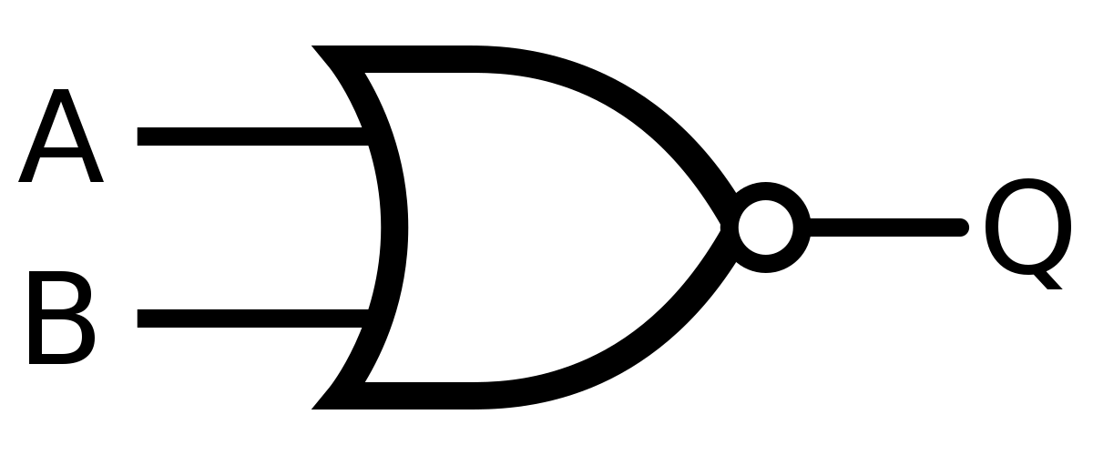
Biologie
NOT Gate
Analogie
Input A | Output Q
0 | 1
1 | 0
Q
A
NOR Gate
A | B | Q
0 | 0 | 1
0 | 1 | 0
1 | 0 | 0
1 | 1 | 0
B
A
Q

Slide 9
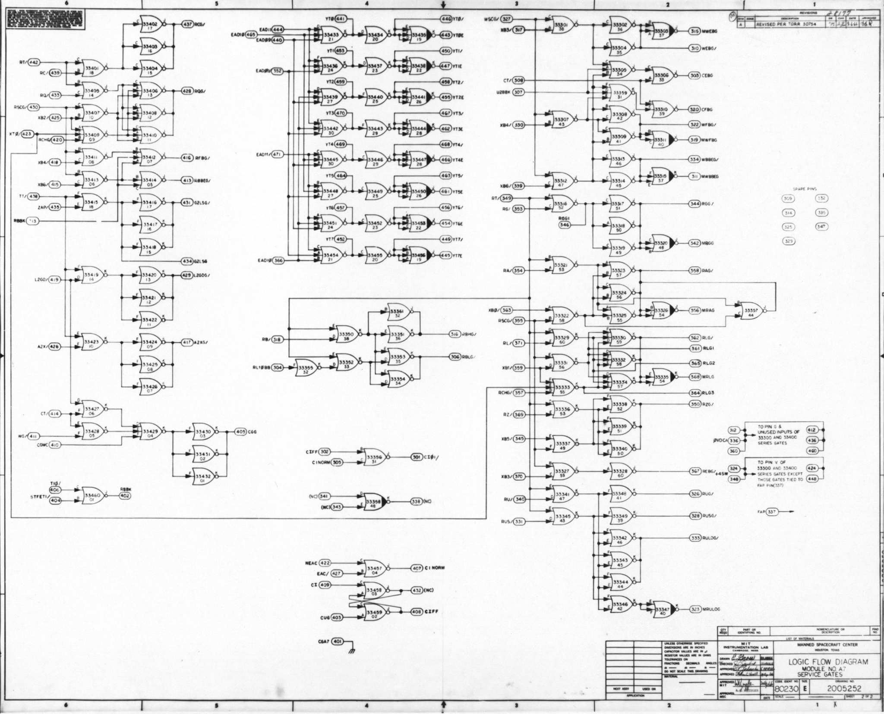
5600
NOR gates

Slide 10
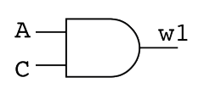
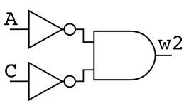
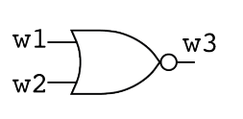
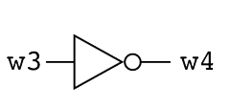
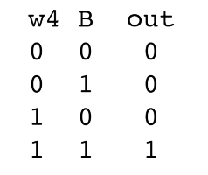
Verilog
module example(output out, input A, B, C);
wire w1, w2, w3, w4;
assign w1 = A & C;
assign w2 = ~A & ~C;
nor (w3, w1, w2);
not (w4, w3);
always@(w4, B)
begin
case({w4,B})
2'b00: {out} = 1'b0;
2'b01: {out} = 1'b0;
2'b10: {out} = 1'b0;
2'b11: {out} = 1'b1;
endcase
end
endmodule

Slide 11
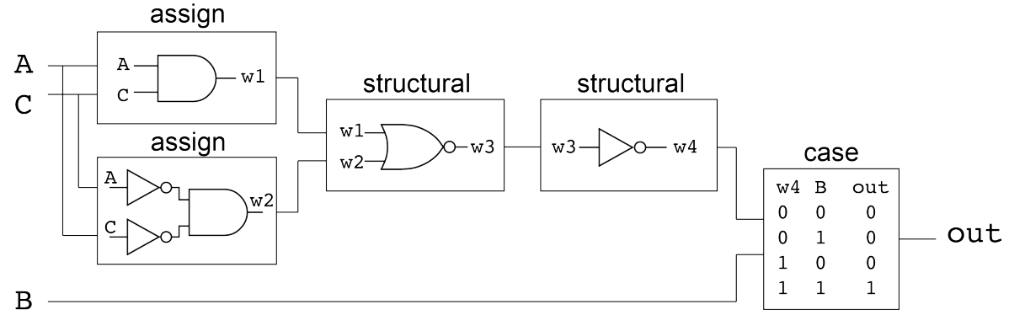
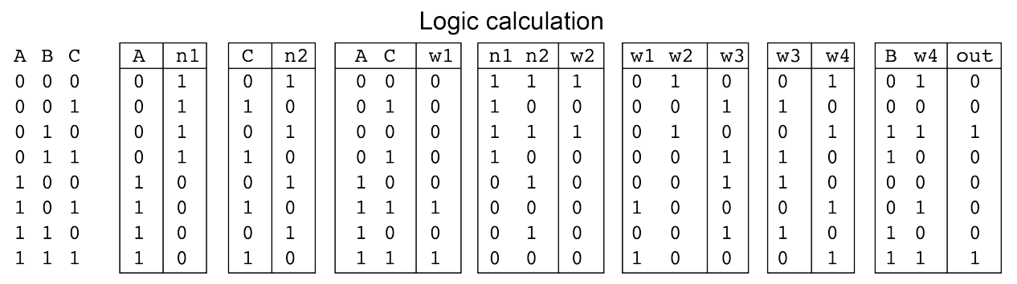
Verilog
Jones, T.S., Oliveira, S.M.D., Myers, C.J. et al. Genetic circuit design automation with Cello 2.0. Nat Protoc 17, 1097–1113 (2022).
https://github.com/CIDARLAB/Cello-v2

Slide 12
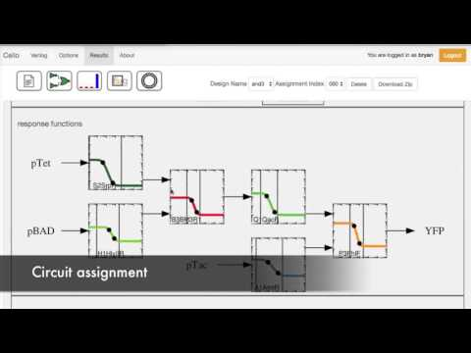

Slide 14
Thank you
@tiffanysouterre

